Slide 1
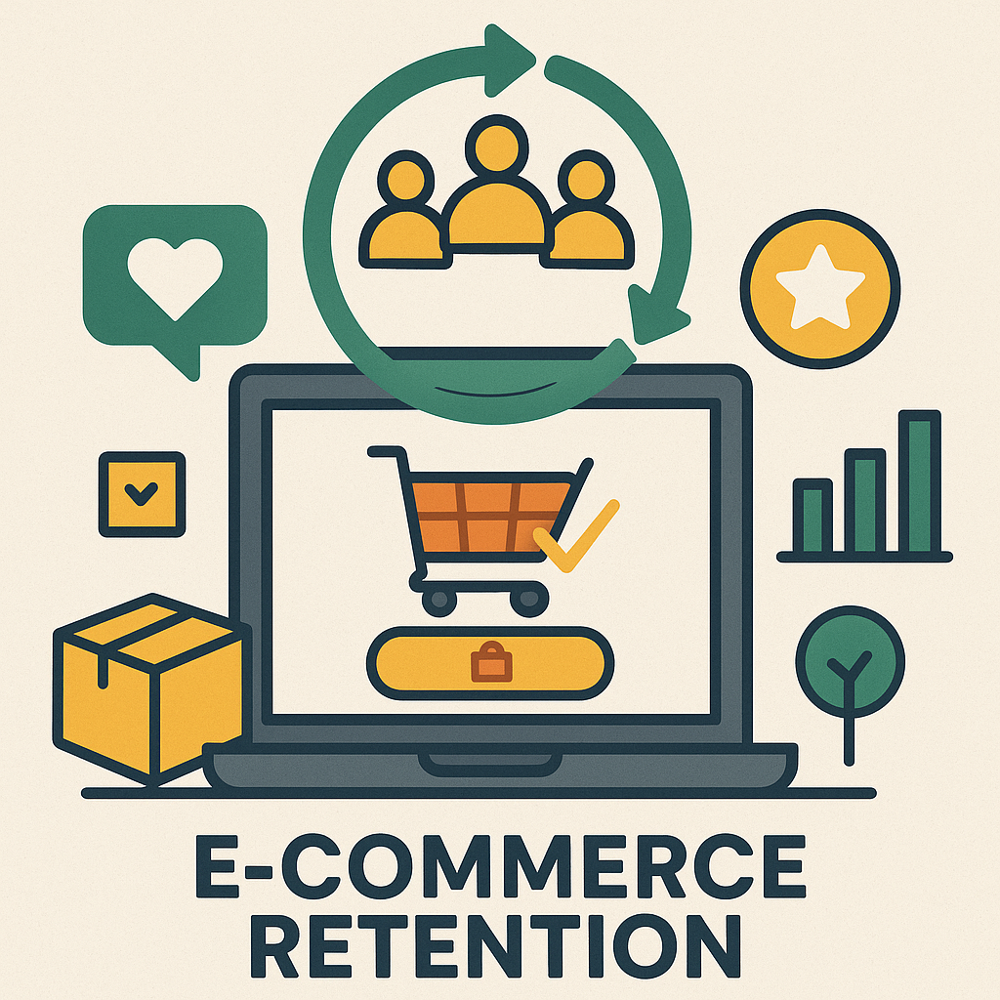
Unlocking E-commerce Growth: A Data-Driven Approach to Customer Retention with SQL

Slide 2
Key Performance Indicators
Repeat Purchase Detection
Identified customers who bought in January and February but have recently lapsed — a prime target for re-engagement campaigns.
Customer Lifetime Value (CLV) Segmentation
Classified customers into High, Medium, and Low value tiers to guide loyalty programs and upsell opportunities.
RFM Scoring (Recency, Frequency, Monetary)
Segmented users based on recent activity, purchase frequency, and spend to anticipate churn and optimize retention strategies.
Cohort Analysis
Tracked user retention by signup month to assess onboarding effectiveness and long-term engagement.
Category Retention Drivers
Uncovered which product categories drive repeat purchases — aligning product focus with retention and marketing goals.

Slide 3
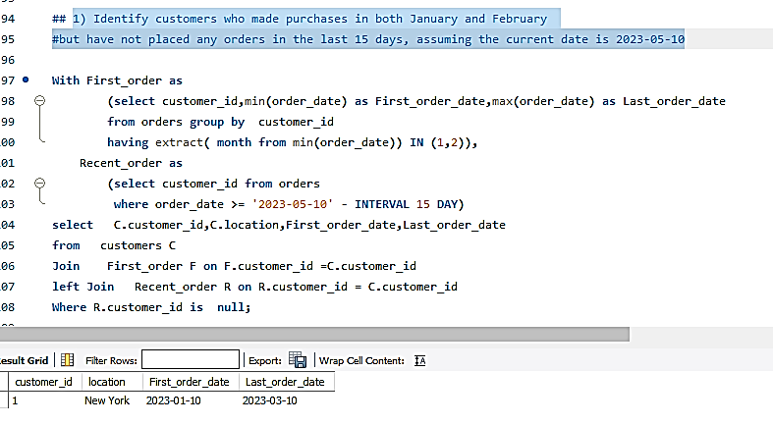

Slide 4
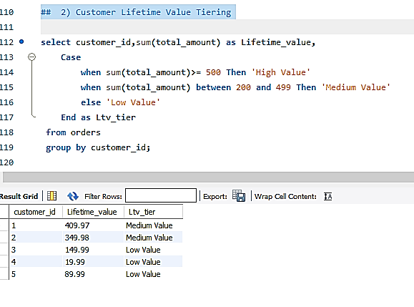

Slide 5
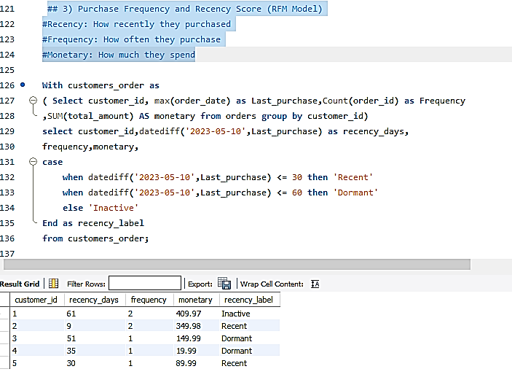

Slide 6
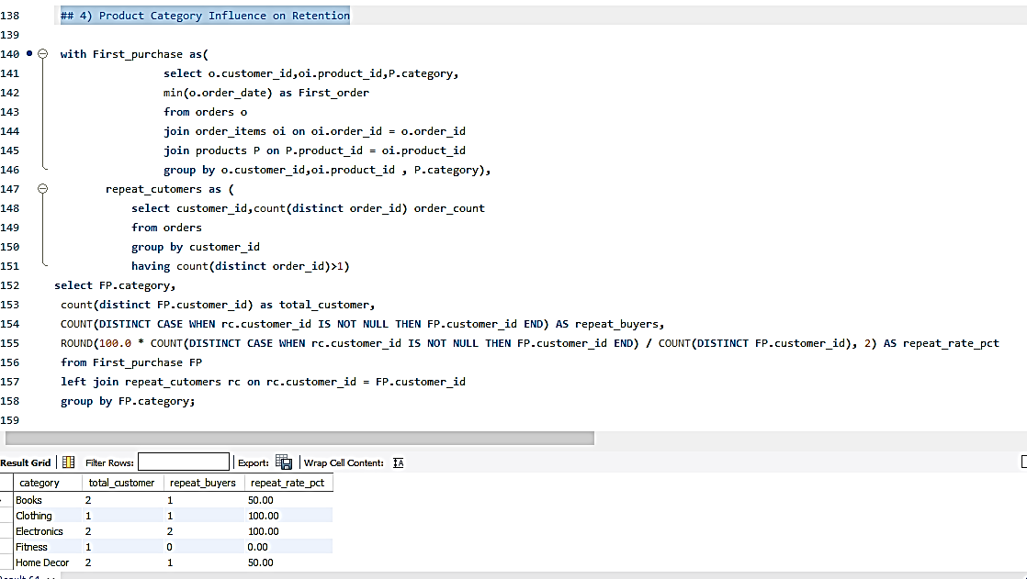

Slide 7
